Slide 1
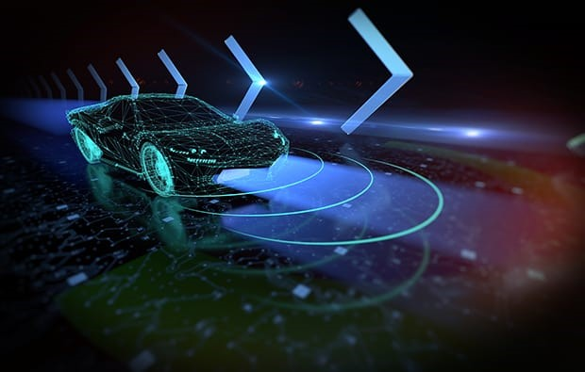

DRIVING SCORE

Slide 2
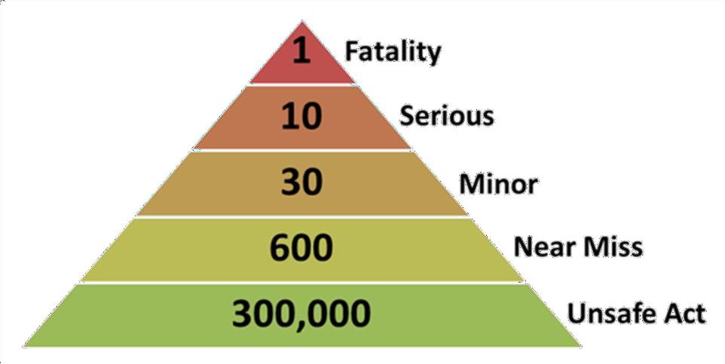
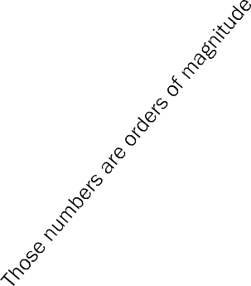

HOW DOES IT WORK
CONTROLLING VEHICLE SPEED TO KEEP DRIVING BEHAVIOR CAUTIOUS
accident
accident
= emergency situation
AVOID or UNDO –by ACC or AD
See theory of risk
Curative (get out of triangle) when it was not possible to avoid entering triangle of risk
^
Risk(t+i)
Selection of the best possible future filtered on RISK
Caution and Risk
assessment
Risk target
Risk(t)
Prophylactic : avoid as much
as possible entering triangle of risk
t Forecasted possible futures depending on trajectory evolutions assumptions
Past
OEM choice
OEM choice
Present
2 stages of anticipation

Slide 3
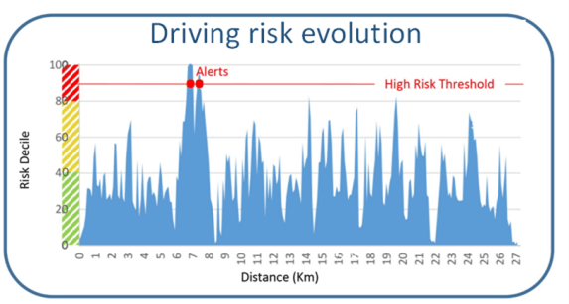
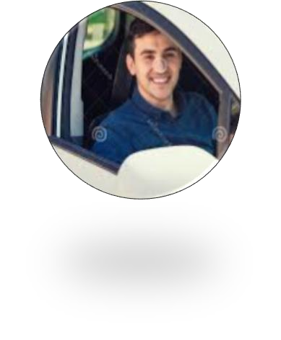
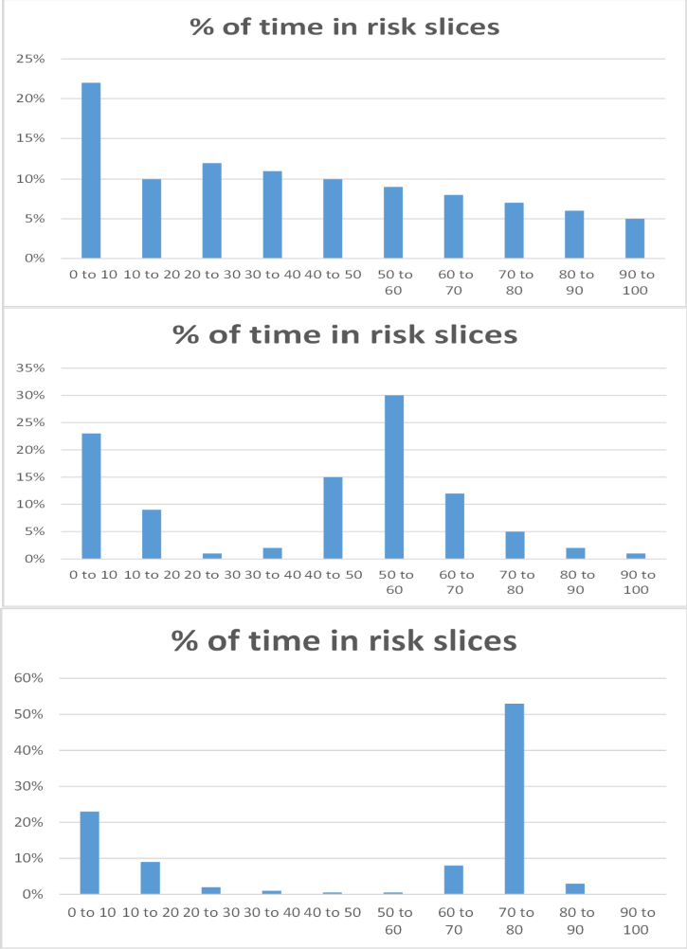


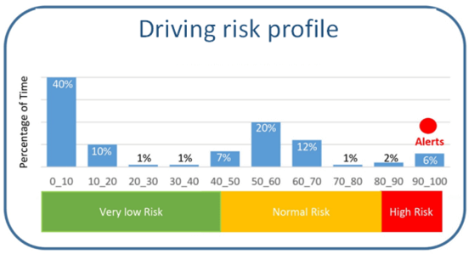
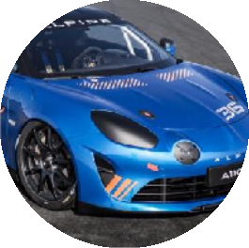
DRIVING SCORE PRINCIPLE:
UNIQUE SET OF DATA TO PROFILE DRIVER
Automatically regognize driver category, follow improvement among time, give awards when driver gets better, …
In real time during driving we record assessed risk 20 times per second
TYPICAL PROFILES
YOUNG / INEXPERIENCED DRIVER
Automatically set risk targets to adap advices and ACC to driver
EXPERIENCED DRIVER
Extract from profile: ability to reproduce risk (skills), risk appetite (self-confidence), ability not to enter triangle of risk (anticipation)
At the end of trip we compute HISTOGRAM of this curve that gives us THE DRIVER’s PROFILE
Driver’s mood (angry, tired, …)
Driving style
PILOT

Slide 4
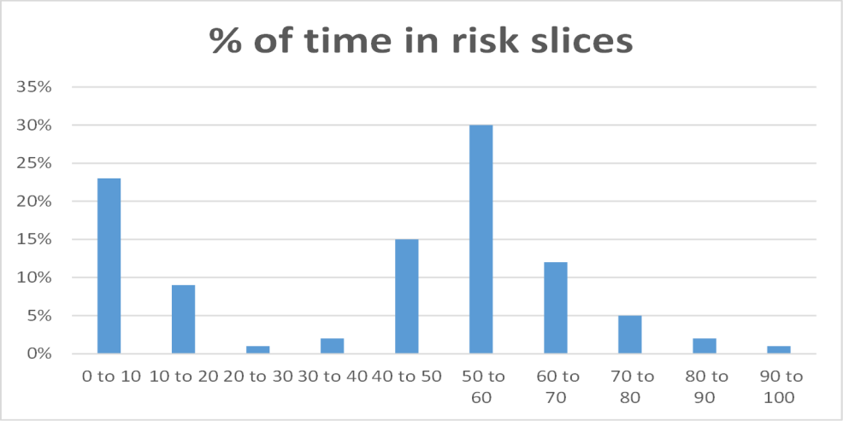

SAFETY SCORE HIGH LEVEL DIMENSIONS
Allows to compute ability to reproduce the same level of risk
= DRIVING SKILLS
Allows to compute appetite to risk
= SELF CONFIDENCE
Allows to compute ability not to enter triangle of risk
= ANTICIPATION

Slide 5
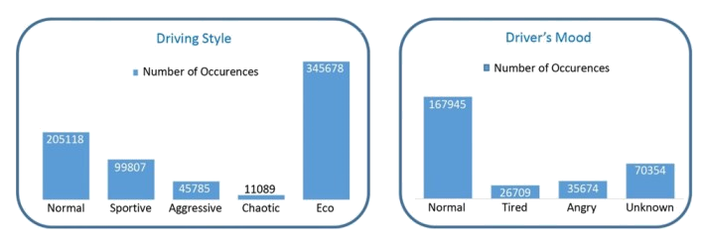
DRIVING SCORE :
MORE DATA ABOUT DRIVER’S BEHAVIOR
Driving style in a result of analysis of acceleration, speed and jerk, in the infrastructure context.
Driver’s mood is result of driver’s usual behavior learning: way of managing risk (risk value for a given infrastructure singularity and trajectory of risk) – if ever risk behavior changes among time, it is detected. If driver if late of if driver is pushing tells if he/she is tired or angry (or late at a meeting), etc …
Rsk (lack of caution) is a key notion for profiling driver. Profiling among time leads to modifications detection.

Slide 6
THANK
YOU
INDIA
©2022 Motiv AI. All Rights Reserved. Motiv AI acknowledges the proprietary rights of other companies to the trademarks, product names and such other intellectual property rights mentioned in this document. Except as expressly permitted, neither this documentation nor any part of it may be reproduced, stored in a retrieval system, or transmitted in any format or by any means, electronic, mechanical, printing, photocopying, recording or otherwise, without the prior permission of Motiv AI and/or any named intellectual property rights holders under this document.

